Slide 1
Job Search Correspondence
Career Lab October 26, 2015

Slide 2
Overview of Remaining Career Labs
Monday, 10/26
Tuesday, 11/2
Wednesday, 11/9
Thursday, 11/16
Job Search Correspondence: cover letters, networking emails, thank you notes
Connecting with employers
Online applications
CMC Connect OCR
Interviewing continued
Conclusion
Plan for the break
Major Activities
Bring a copy of a recent cover letter, networking email, and thank you to class
Update your CMC Connect Account
Update your LinkedIn profile
Draft three STAR responses to select core competencies: leadership, analytical skills, failure
Pre-work

Slide 3

The problem

Slide 4

The goal
Notes:
You want the employer to pluck your documents out of the pile with the same enthusiasm and wonder as Charlie finding the golden ticket

Slide 5



Goals and agenda
Types of Job Search Correspondence
Construction & Practice
Important Points

Slide 6

Main types of job search correspondence
Resume
Cover letter
Email
Networking email
LinkedIn invitations
Thank you notes
Notes:
Here are the six main types of job search correspondence, however we’re not going to discuss resumes today and we’re going to go through cover letters at the end.

Slide 7
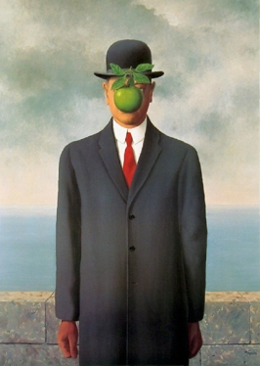
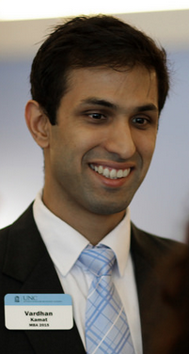
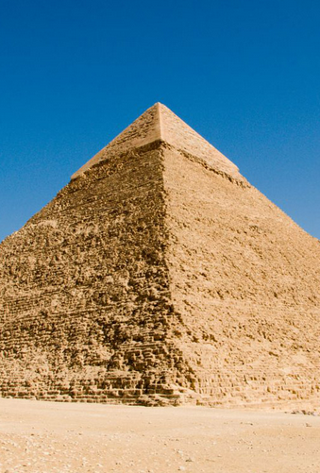
Why it matters
A tangible representation of your professionalism
Often your first impression
It’s a permanent medium

Slide 8
Example email to an alumnus
Subject: UNC MBA student seeks your guidance
Alumni students; Leverage UNC
Dear Daren:
I hope that you’re having a good day. I’m a MBA student at UNC Kenan-Flagler and I’m exploring potential career paths. Similar to you, I have a passion for sports and I’m an ardent Tar Heel fan.
I have done extensive research to learn more about Nike’s strategic expansion in emerging markets and focus on core athletes. To complement this digital research, I would appreciate hearing your views on Nike’s global businesses.
I understand that you are busy, so I thought it would be helpful if I proposed a few blocks of time that might align with your schedule. Would you be available for a 15-20 minute phone call during either of these blocks of time?
Tuesday, 4 – 7PM Pacific Time
Wednesday, 7 – 10AM Pacific Time
Thank you in advance for your consideration. Would you be willing to speak with me?
Regards,
Ramses Tar Heel
Make an early connection
Demonstrate you’ve done research
Bullets make this stand-out
Use his time zone
Use pre, during, and post-work times
Ending with a question invokes action
Keep it brief! <150 words

Slide 9
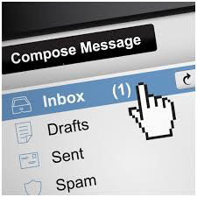
Networking emails
Introduces you to reader
Flawless grammar and spelling
Brief emails of introduction
Clear purpose
  Not asking for a job or contacts
  Ask for advice, thoughts on the MBA job search, insights about your industry

Slide 10
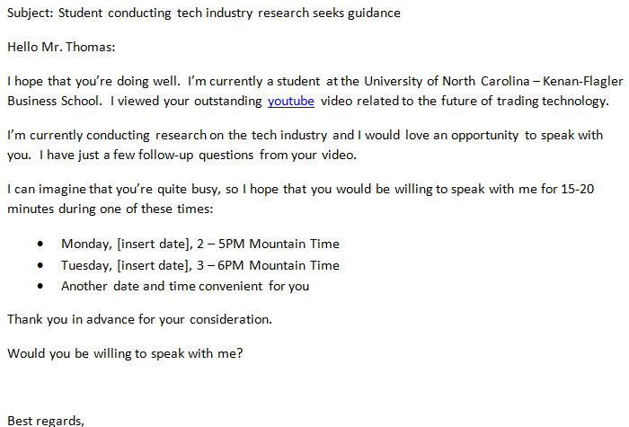
Suggestions for a non-connection email
Use student card
Broad, but not too broad
Flattery works well
Other tips:
Always end with “?”
Wait 6 days; follow-up nicely
Ask 3 times
Consider phoning if number available
Be persistent
Notes:
Update this to a random person. They don’t need to do the exercise.

Slide 11

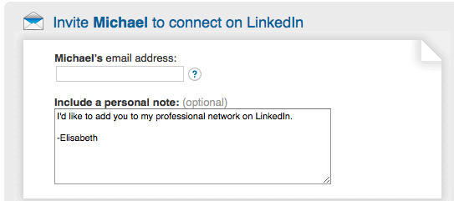
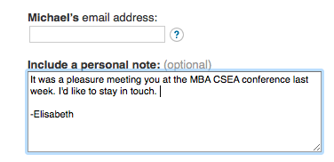
LinkedIn invitations
Do:
Connect with people with whom you’ve had a significant interaction
Compose a personal message
Reference the source of your connection
Don’t:
Use the auto message
Connect with people you don’t know
Fail to note your source of connection

Slide 12

Thank you notes
Reminder of your conversation
Reiterate your key selling points
Reinforce your interest
Note/remind of next step (if applicable)
State intent to stay in touch
Can be handwritten or email

Slide 13
When to write thank you notes?
✔ ✔
After
  Conversations at networking events
  Interviews
  Phone calls
  When in doubt, send a thank you
A) Right away B) Within 24 hours C) A few days later
Not ideal, but better than never

Slide 14
A thank you email
Does this sentence say anything unique about consulting firms? Could it be made easier to read?
Dear Mr. Smith,
Thank you for the time that you spent with me during the hospitality reception last Friday.at the Ritz-Carlton on the evening of 14th September The discussions on the various business practices at Bain, how it distinguishes itself from other consulting companies, and the challenges faced while implementing change in various organizations were very intriguing.
Given my background in the energy sector, I want to join Bain because that would ensure cross-functional exposure in the wide range of energy related projects that Bain executes. The wide variety of industries that a Bain consultant gets to associate with is also very invigorating.
It was great talking to you. Thanks!
MBA Student
Should be two paragraphs.
How does this show the value her background would add to Bain?
Is this a good way to close?

Slide 15
One thank you email
Dear Phil—
It was a pleasure to speak with you over the phone. I learned so much about Google! I have attached my resume. Please send it to any hiring managers you know.
Thank you,
John
Common errors:
Non-specific learning
Attaching the resume too early

Slide 16
A proper email thank you
Dear Phil:
It was a pleasure to speak with you today. You significantly supplemented the online research I have collected about Google. Specifically, I appreciated your insights on Google’s:
Dynamic mobile platform responsive search results
Autonomous vehicle navigation systems and potential to deliver search results in transit
Success factors for product managers, including excellent cross-functional skills and the ability to understand insights from large sets of data
I look forward to a continued networking relationship over the next few weeks.
Thank you,
John
Remind them you’ve done research
Be very specific with your learnings
We are just getting started – this is a relationship

Slide 17
Sustain networking over time
Happy Thanksgiving (it’s good to show humanity)
Update on your internship search process
Phone call thank you
September
October
November
December
January
Short questions on quarterly results
Something learned in class or news article

Slide 18
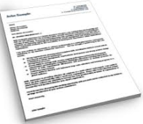
Cover letters
Introduces your resume
Explains how you will add value and address the company’s specific needs
  Why are you interested?
  How well do you understand the company, position and their pain points?
  What makes you the most qualified candidate?
Reflects your professionalism, written communication
Notes:
Photo of a cover letter?

Slide 19

Is a cover letter really necessary?
I will require and will read a cover letter for consideration, and please advise your students to avoid a generic template.
Theresa Brown, MBA Staffing Consultant, University Recruiting, Microsoft
Notes:
Remove the random bullet point.

Slide 20

Three things a cover letter should be
Engaging
Unique
Perfect

Slide 21
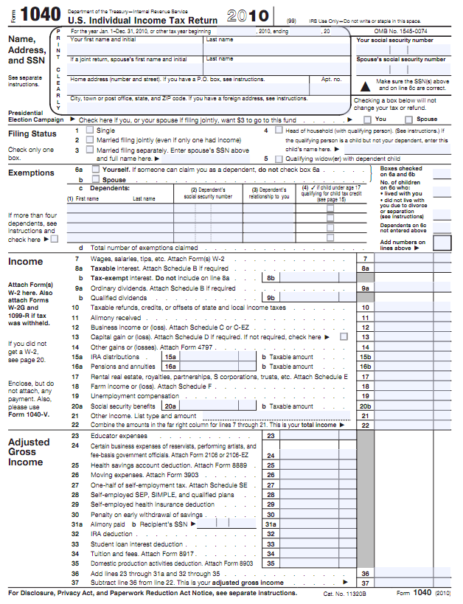
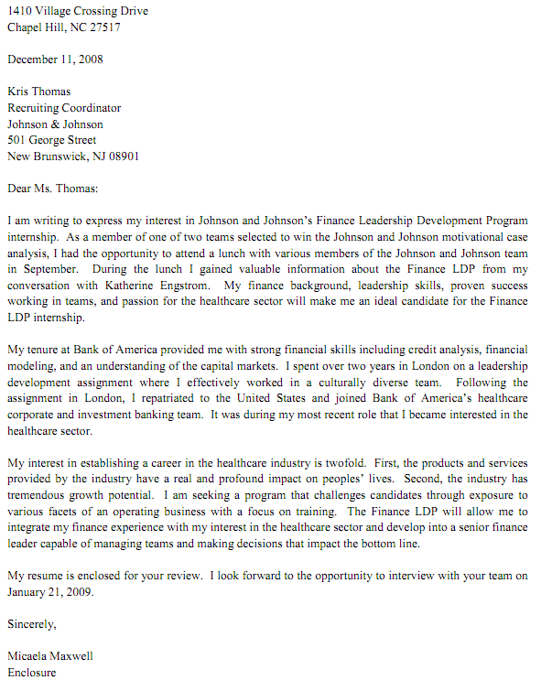
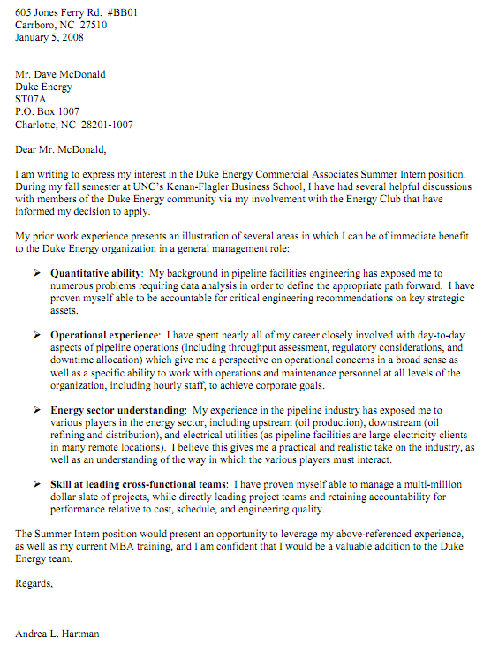
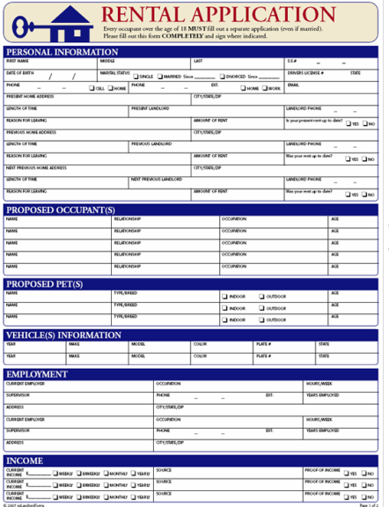
Documents often follow a format
Structured  Accessible  Concise Typical  Predictable  One-Size-Fits-Most
Tax forms, applications, etc
Cover letters

Slide 22
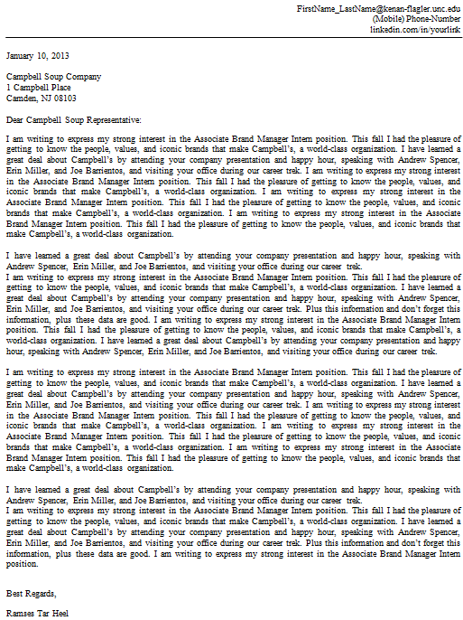
Consider the document’s visual impact
Things To Avoid!
Very long paragraphs
Starting too many thoughts with “I”
Margins that are too broad or too narrow
Non-standard typeface or font size
Fancy bullets or other pointless flair
Want to read this?

Slide 23
Recommended cover letter outline
The header should match your resume
Date submitted
Contact name, with proper title
Company name and physical mailing address
Recruiting contact (often can be found in CMC Connect); if not available, use “Dear _______ Representative (with name of company)
Sincerely, Regards, or Best regards,
Your name

Slide 24
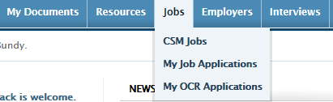
Finding the right person / getting names right
Example – GSK
You check CMC Connect – primary contact listed is Frankie Stewart – no Mr. or Mrs. listed in CMCC. Is Frankie a man or a woman?
Note that the email listed says Frances -frances.m.stewart@gsk.com – still could be either
Now go to LinkedIn – search for Frances Stewart at GSK – learn she is a woman
Address letter as Dear Ms. Stewart: and be sure to use her appropriate title in the mailing address of the cover letter
Notes:
We need to redo this slide!!! GSK not good example – not visible to students as primary. Only some companies have contact info listed under the job description.

Slide 25
Answers to common questions
Question | Answer
How do I find the Company mailing address? | Use CMC Connect or company website
To whom should I address the letter? | Dear [CMC Contact; Hiring Manager; HR Rep] Dear [Insert Company Name] Representative (only as a last resort!)
Do I use a colon or comma to end the salutation? | First or formal interaction ⇨ colon “:”
Do I need to include an actual signature? | No
Should I mail the letter? | No, email only
In what format should I save the letter? | Adobe Acrobat (.pdf) whenever possible
Where do I “drop” my resume? | UNC ⇨ CMC Connect (read instructions!)
How many representatives should I reference? | Max 4 people (Banking companies included)
Is there an advantage to apply early? | UNC ⇨ It depends; likely small. External ⇨ Probably; apply early!
Can it be >1 page? | No

Slide 26
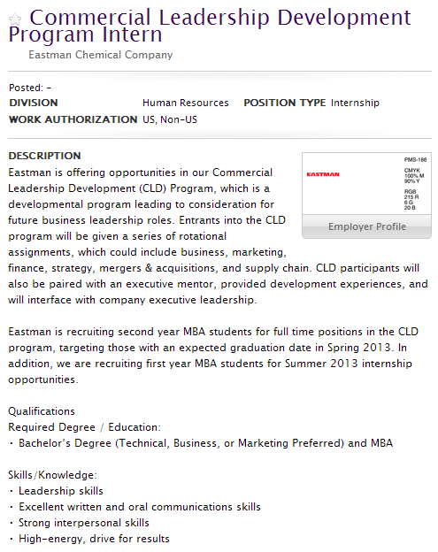
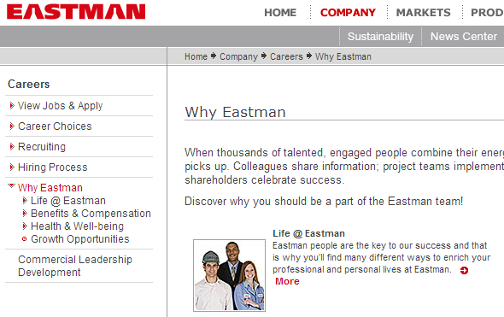
Where to start? The job description…
company presentation notes
+
+
networking discussions
what
they seek

Slide 27
The introduction
People
You
Know
Who You Are
What
You
Learned

Slide 28
The intro – who you are & who you know
Objectives
Identify yourself and the position
Provide your “reference check”
Good example
I am writing to express my interest in the Investment Banking summer associate program at UBS. Currently, I am a first year MBA student at UNC Kenan-Flagler Business School. I recently had a phone call with Tom Collins, a managing director in the New York City leveraged finance group, and he discussed the geographic expansion model into China. With my previous work experience in China…
Poor example
I am writing to express my interest in UBS. At the company presentation, I met with Phil Wads, Jessica Thomas, John Reuters, Amy Barkdale, Ty Cobb, Austin DeKoff and Jenny Baker.
UBS may have multiple positions
Don’t laundry list people

Slide 29

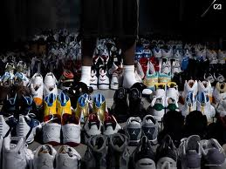
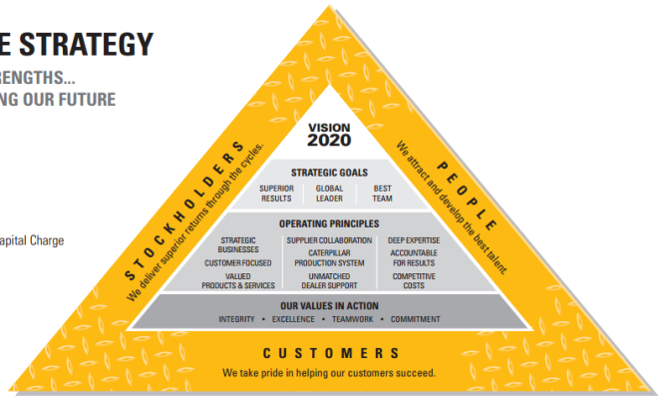
What if you don’t have a personal contact?
Nostalgia
Zealot
Strategy / Event
My parsimonious grandfather helped me open my first savings account with PNC bank 25 years ago and I’m still a loyal customer.
I have more than 200 Nike shoes including 25 Air Force Ones, 6 original Air Jordans, and a pair of the new Lebrons.
Caterpillar’s solid Q3 results demonstrate the vast scale of an organization with a global footprint and the importance of a well-defined international strategy.
Notes:
Revise these pictures and check on the new Lebron 10s?

Slide 30
The body
Skills
How yours fit
Experience
How it relates
Abilities
Make an impact
Notes:
I think perhaps we need an interstitial body slide here. This is the most important and we need to demonstrate how this translates. Make it very clear for them.

Slide 31
The body – showcase your experience
Objective
Explain why your previous experience is relevant for the summer internship. Show that you can make an immediate impact.
Good Example
Before business school, I was a consultant with Bain & Co. I had an opportunity to partner with ABC Corporation, a major healthcare organization to identify additional market expansion opportunities. By analyzing quantitative demographic data, forecasting product demands, and estimating supply chain costs, I was able to make a new product entry recommendation. This type of data analysis experience will allow me to make an immediate impact at McKesson Corporation this summer.
I have relevant experience
Analyzing data is my skills
I just connected the transferable skills

Slide 32
The close
Pitch
Why You
Close
Next Step

Slide 33
Putting it all together…
What they seek
What you have
General Management
Analytical Ability
Retail experience
Leadership
Int’l expertise
Interpersonal skills
Strong Communication
Channel Management
Creativity
Teamwork
Forecasting
Biz Development
Skill overlap is the foundation of your letter

Slide 34
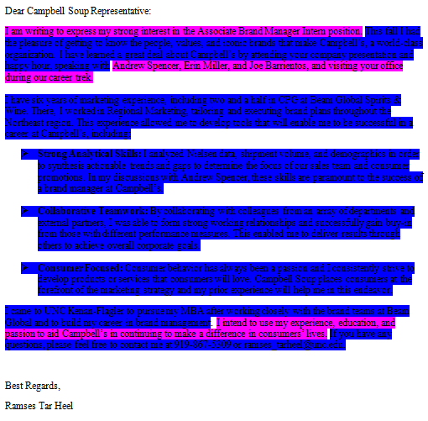
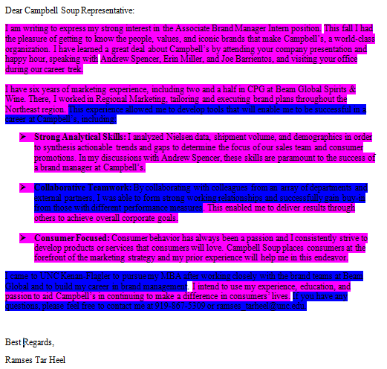
Let’s be honest, life is time-constrained
Standard content
Goal: 70% original content
Company/position specific
Inferior cover letter
Superior cover letter

Slide 35
Final Check – The Details Count!
Is the company name correct?
Are the contact names spelled correctly?
Is the grammar perfect?
Are there any typos?
Is it engaging?

Slide 36

Activity: cover letter peer review
15 minutes
Is it error free?
Is it clear?
Does it follow a logical structure?
Is it compelling?
Are skills translated?
In pairs review each other’s cover letter & provide feedback

Slide 37
Additional Resources
Canvas Career Launch
Business Communication Center
Career Mentor
Peer review
Career Management Center AD

Slide 38

And Just Remember…
…great job search correspondence isn’t everything
Keep
Networking!
Applicants
Interviewed

Slide 39

Questions?

